Slide 1
Sustainable dairying for the next 10 years and beyond
John B. Cole, PhD
PEAK Sr. VP for Research & Development
john.cole@urus.org

Slide 2
Topics for discussion
What does sustainable dairying look like?
How are productivity and fertility related to sustainability?
How do we breed a sustainable cow?
Closing thoughts
Source: Author.

Slide 3
What does sustainable dairying look like?

Slide 4
What is sustainability?
“Sustainable development is development that meets the needs of the present without compromising the ability of future generations to meet their own needs.”
Source: United Nations (1987, https://digitallibrary.un.org/record/139811)

Slide 5
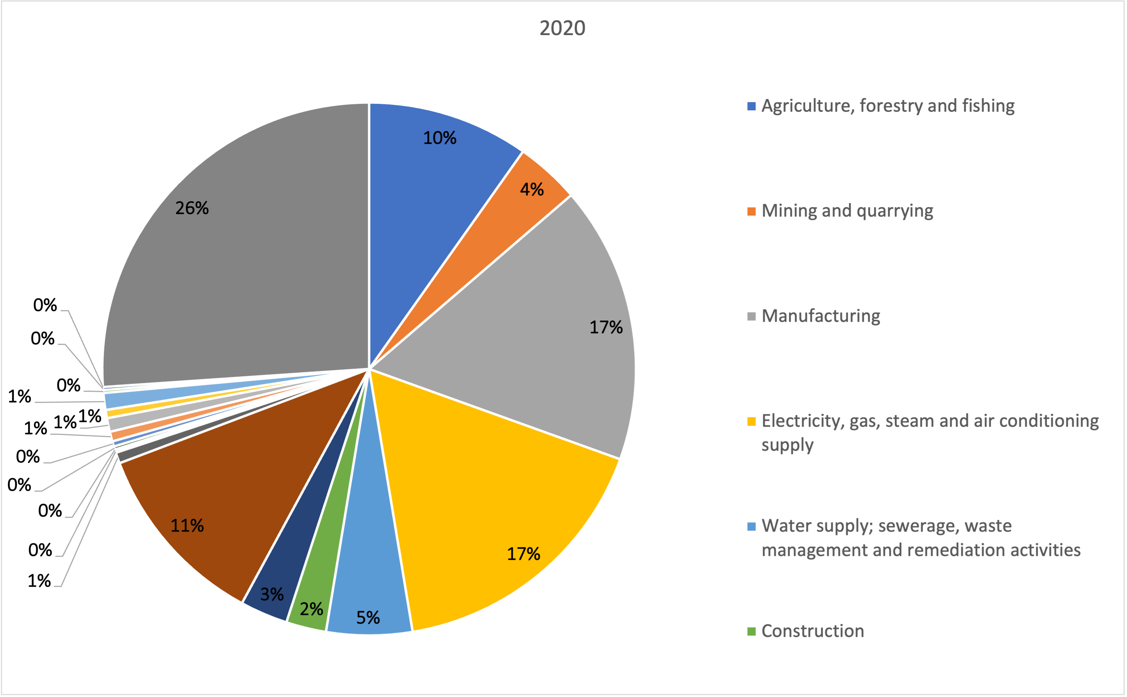
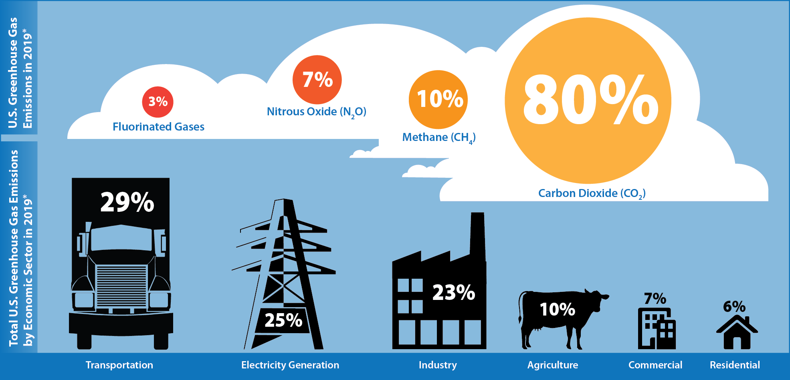
Dairy impacts the environment
Source: U.S. EPA (2021; https://cfpub.epa.gov/ghgdata/inventoryexplorer/).
Source: Office for National Statistics; (https://www.ons.gov.uk/economy/environmentalaccounts/datasets/ukenvironmentalaccountsatmosphericemissionsgreenhousegasemissionsbyeconomicsectorandgasunitedkingdom)

Slide 6
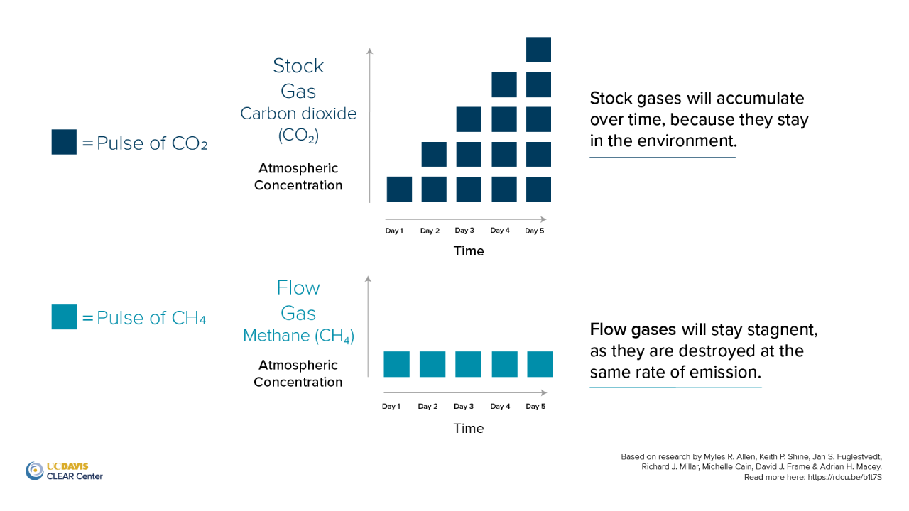
Not all gasses are equal

Slide 7
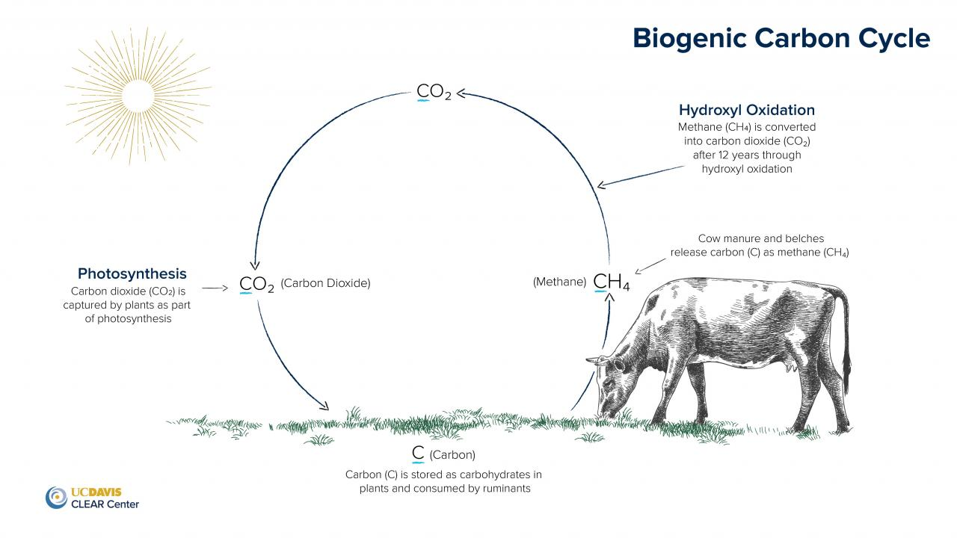
Cattle emissions are part of a natural cycle
Source: https://clear.ucdavis.edu/explainers/biogenic-carbon-cycle-and-cattle.

Slide 8
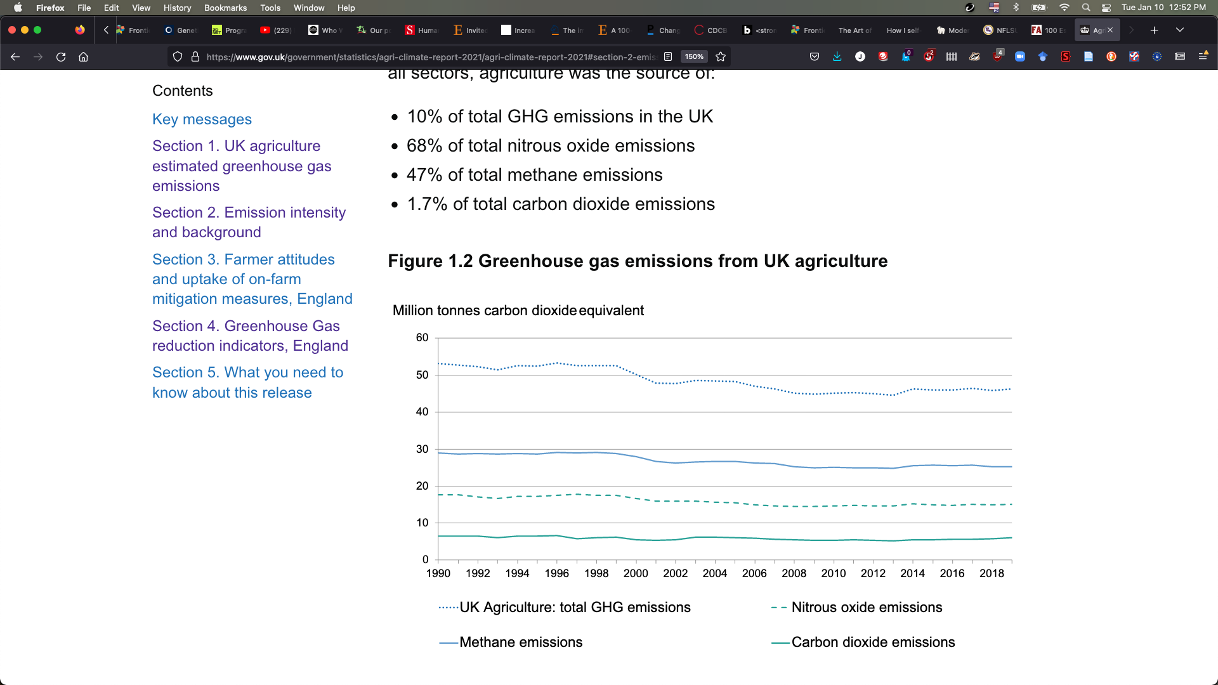
GHG emissions for UK agriculture are steady
Source: DEFRA Agri-climate Report 2021.

Slide 9
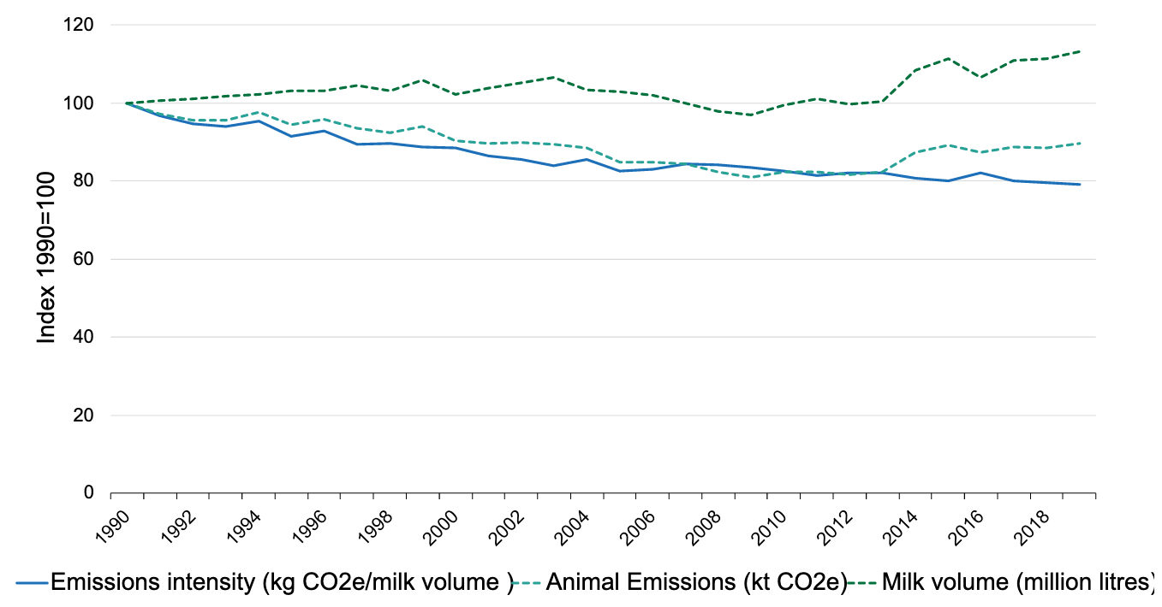
Emissions intensity is down in the UK
Lower intensity corresponds to lower GHG emissions per liter of milk produced
Source: DEFRA Agri-climate Report 2021.

Slide 10

Dairy Roadmap achievements
Dairy producers have achieved:
24% decline in GHG emissions associated with milk production
43% of dairy farmers implement or use renewable energy
78% of farmers implement water efficiency measures
73% of dairy farms implemented nutrient management plans
Source: AHDB Dairy Roadmap (https://ahdb.org.uk/the-dairy-roadmap).

Slide 11
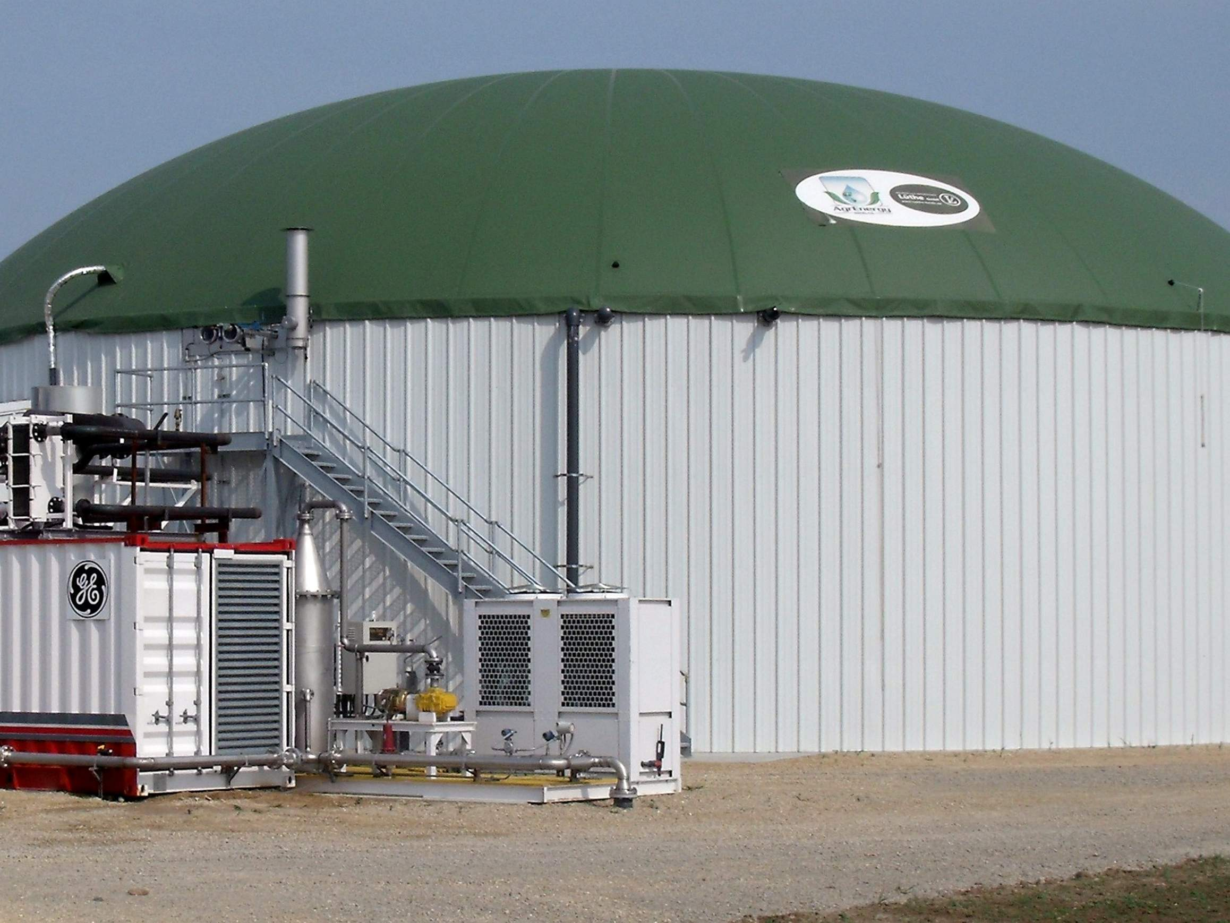
The bottom line
Overall trends are favorable, but there are opportunities for improvement
If dairy farmers don’t set their own path, others will do it for them

Slide 12
How are productivity and fertility related to sustainability?

Slide 13
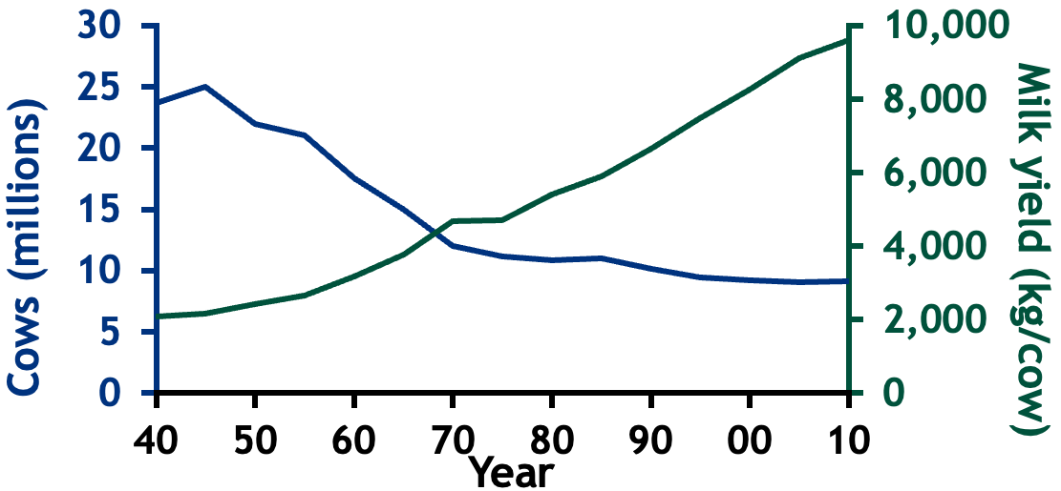
Cow productivity has grown considerably
More milk, fat, and protein from fewer cows
Less demand for feed, water, land
Smaller farms may struggle with economies of scale
Larger farms have more trouble dealing with waste

Slide 14
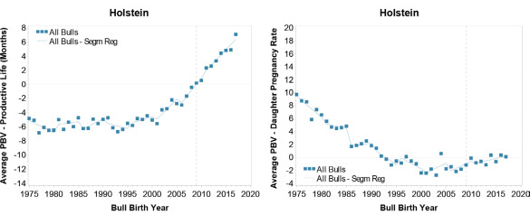
Trends are now favorable for PL and DPR
Source: Guinan et al. (2023; https://doi.org/10.3168/jds.2022-22205).

Slide 15
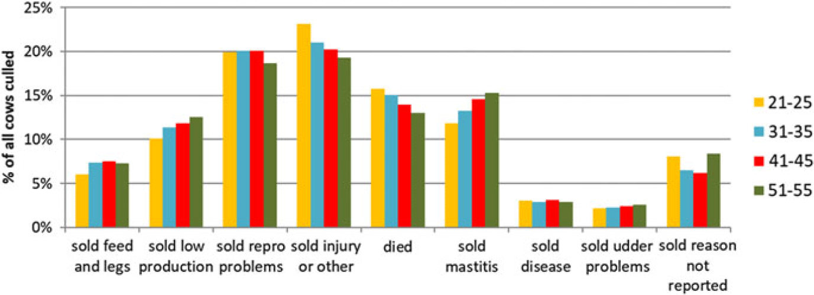
Why are cows most commonly culled?
Categories are culling rate (yellow = low, green = high)
US data – UK cows may exit for different reasons
Source: De Vries and Marcondes (2020; https://doi.org/10.1017/S1751731119003264).

Slide 16
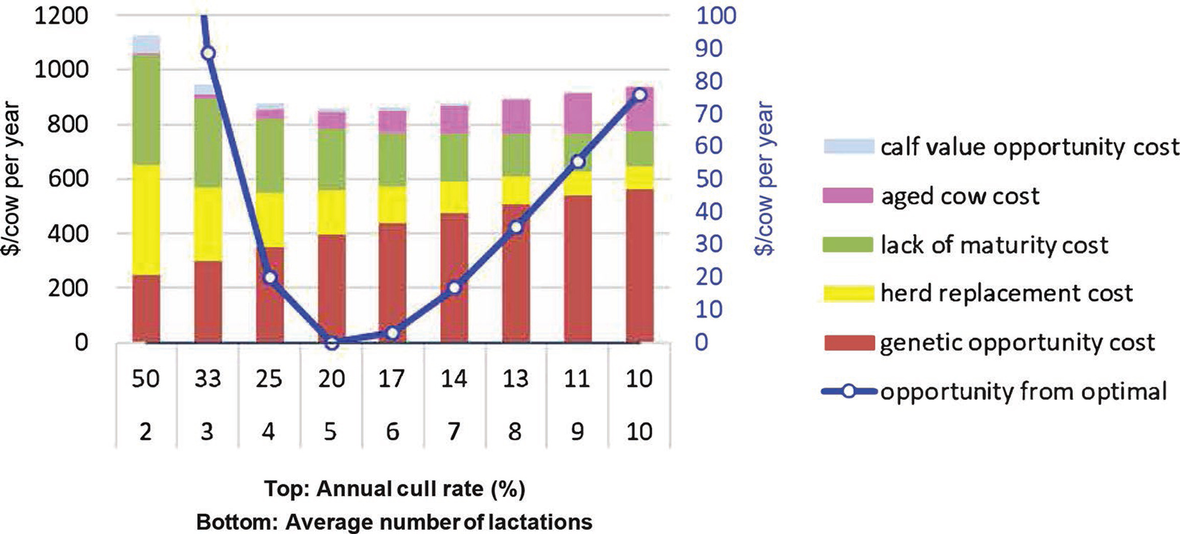
How long should cows stay in the herd?
There is a balance between age and profitability because younger cows have greater genetic potential.
Is genetics actually limiting, or is it feeding, housing, and other factors?
Older cows are more profitable when genetic opportunity cost is lower.
(The blue line goes with the right axis, and the bars go with the left axis.)
Source: De Vries (2020; https://doi.org/10.3168/jds.2019-17361).

Slide 17
How is sustainability related to other traits?
Genetic Relationships
 | Milk¹ | PL | DPR | HCR | CCR | RFI | CH₄
Milk | 0.20 | 0.11 | -0.34 | -0.14 | -0.22 | -0.01 | 0.21
PL |  | 0.08 | 0.54 | 0.31 | 0.63 | -0.08 | 0.03
DPR |  |  | 0.04 | 0.51 | 0.93 | 0.09 | 0.17
HCR |  |  |  | 0.01 | 0.59 | 0.02 | N/A
CCR |  |  |  |  | 0.02 | 0.04 | N/A
RFI |  |  |  |  |  | 0.14 | 0.31
CH₄ |  |  |  |  |  |  | 0.12
¹PL = Productive life (longevity), DPR = Daughter pregnancy rate (fertility), HCR = Heifer conception rate (fertility), CCR = Cow conception rate (fertility), RFI = Residual feed intake (efficiency), and CH₄ = Methane production (sustainability). Heritabilities are on the diagonal.
Source: López-Paredes et al. (2020; https://doi.org/10.3168/jds.2019-17597); Manzanilla-Pech et al. (2021; https://doi.org/10.3168/jds.2020-19889); VanRaden et al. (2021; https://www.ars.usda.gov/ARSUserFiles/80420530/Publications/ARR/nmcalc-2021_ARR-NM8.pdf).

Slide 18
How do we breed a sustainable cow?

Slide 19
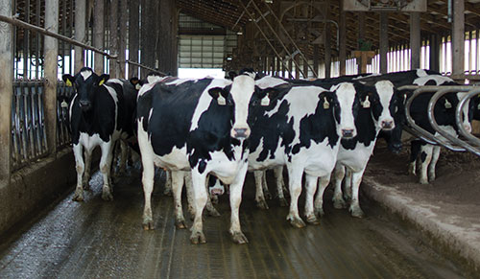
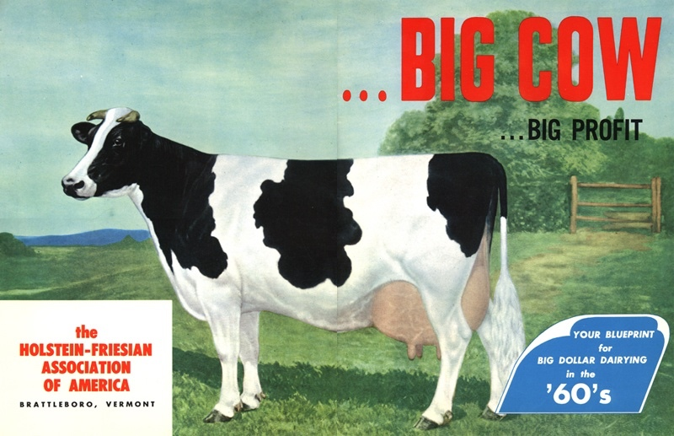
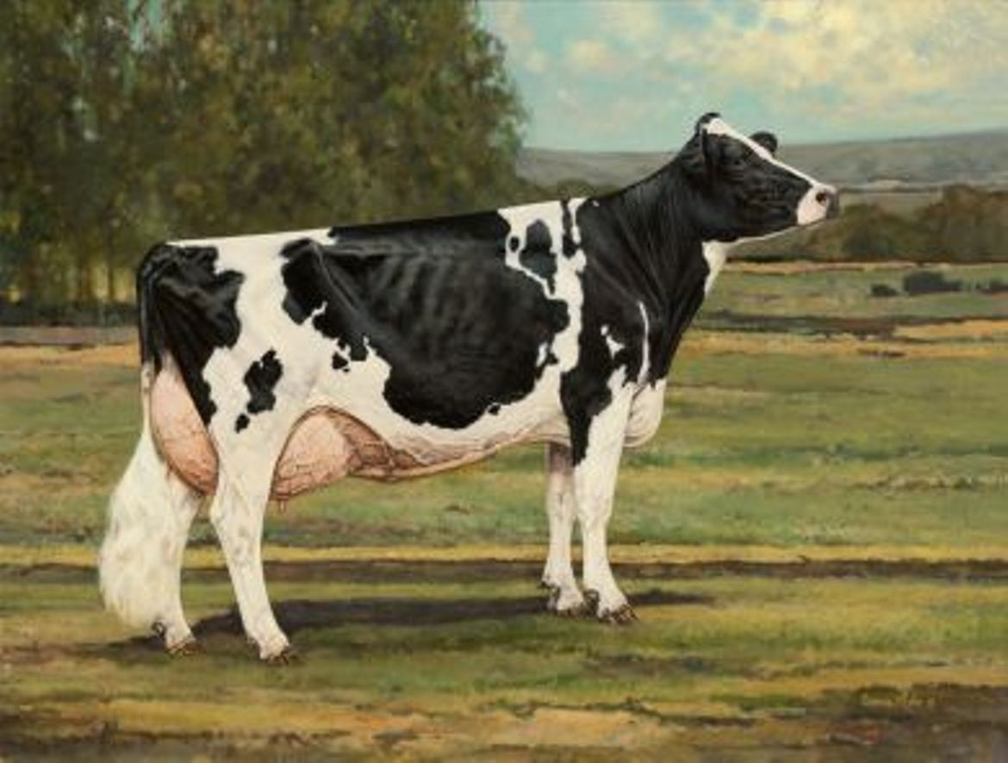
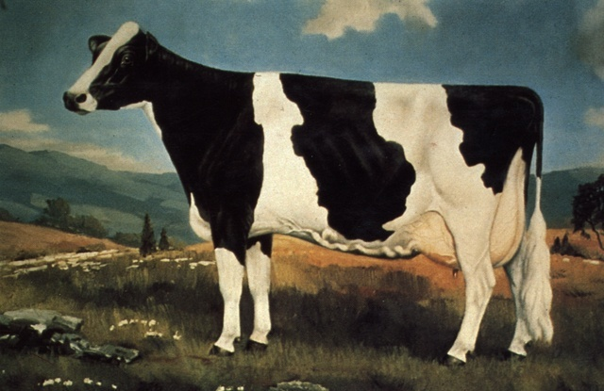
You can’t milk the same cow forever
U.S. Ideal Holstein – 2020s?
U.S. Ideal Holstein – 1960s
U.S. Ideal Holstein – 2012
U.S. Ideal Holstein – 1970s

Slide 20
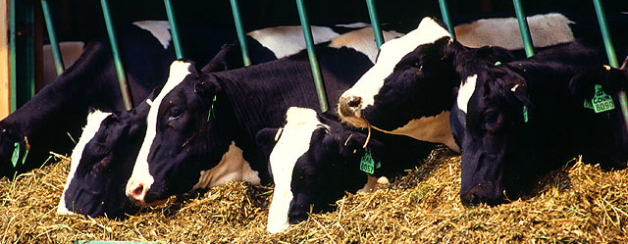
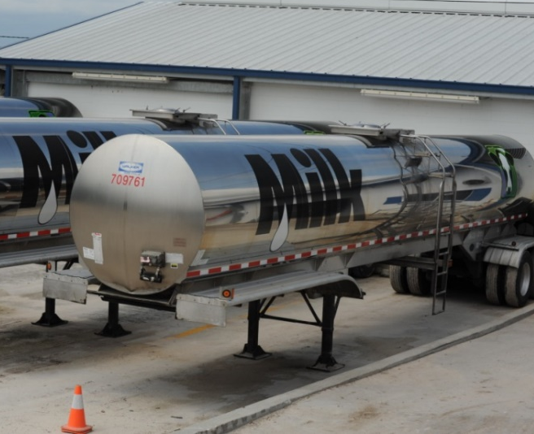
#PhenotypeIsKing
Current milk recording schemes
Many farms participate
Low-intensity phenotyping (few measurements per cow)
Well-suited to traits with low recording costs
Source: ARS, USDA
Source: North Florida Holsteins
Source: John B. Cole

Slide 21
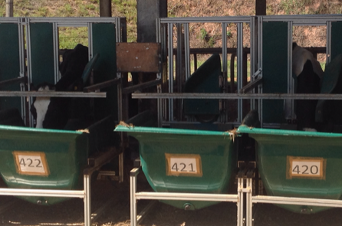
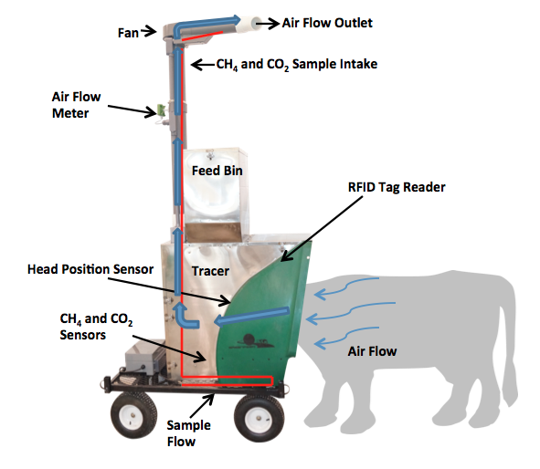
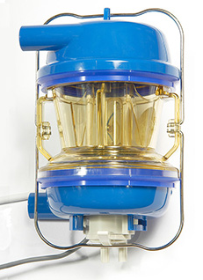
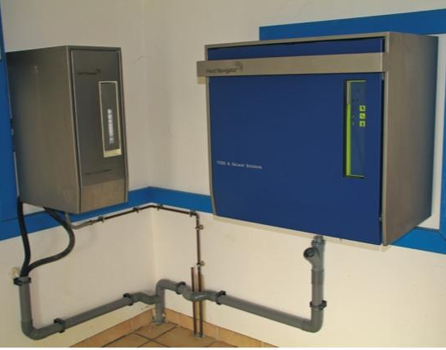
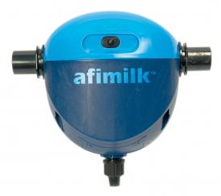
New phenotypes are expensive
Some farms may become data brokers
A small number relative to current participants in milk recording
Intensive phenotyping (many measurements per cow)
More manageable for expensive-to- measure traits
Source: John B. Cole
Source: http://c-lockinc.com/
Source: http://www.afimilk.com/
Source: http://goo.gl/wu8YtR

Slide 22
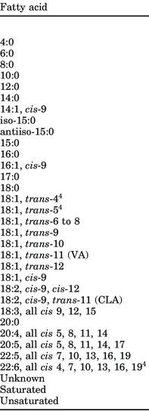
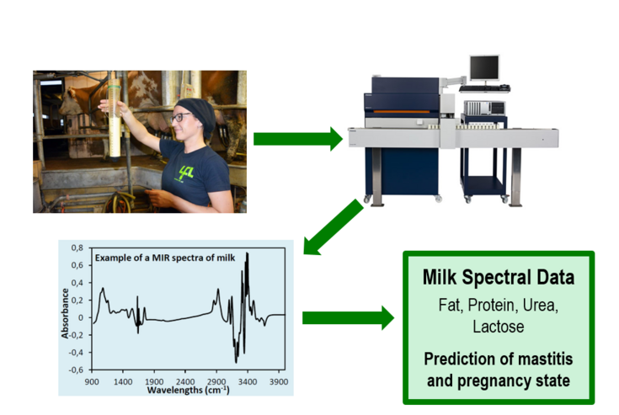
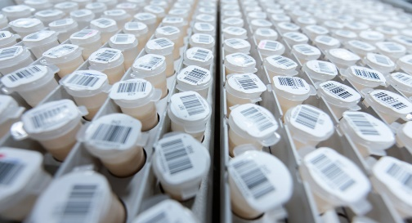
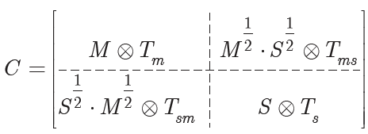
The milk sample can tell us more
Test-day sample
+
Milk Testing Laboratory
Absorbance Spectrum
Laboratory
Measurements
use to…
Predict Phenotypes for All Tested Animals
Prediction Equation

Slide 23
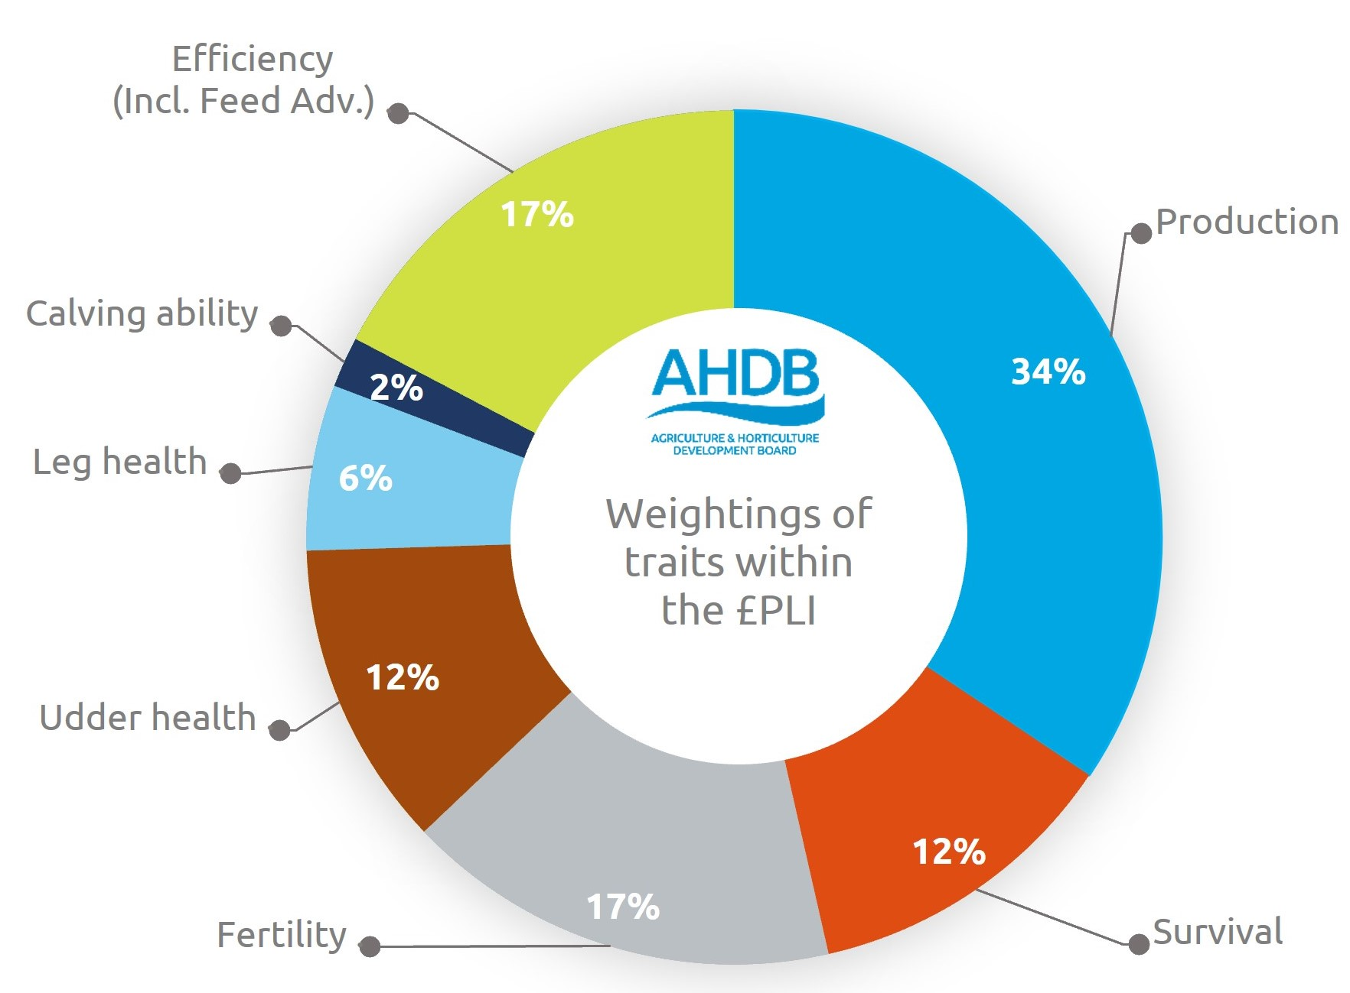
£PLI is a good selection tool
Look for an index that includes:
Production
Feed efficiency
Fertility
Longevity
Good udders
Everything else will come along!
Source: AHDB (2022; https://ahdb.org.uk/knowledge-library/profitable-lifetime-index-pli).

Slide 24
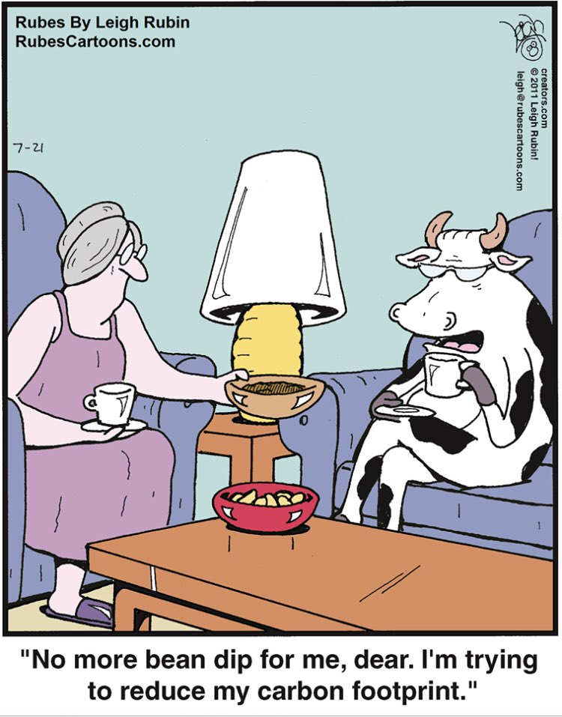
What will the cow of the future look like?
Efficient
Smaller and rounder
Long-lived
Fertile
More solids
Heat-tolerant
Polled
Robust
Desirable carcass
Purebred

Slide 25
Some closing thoughts

Slide 26
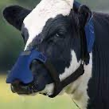
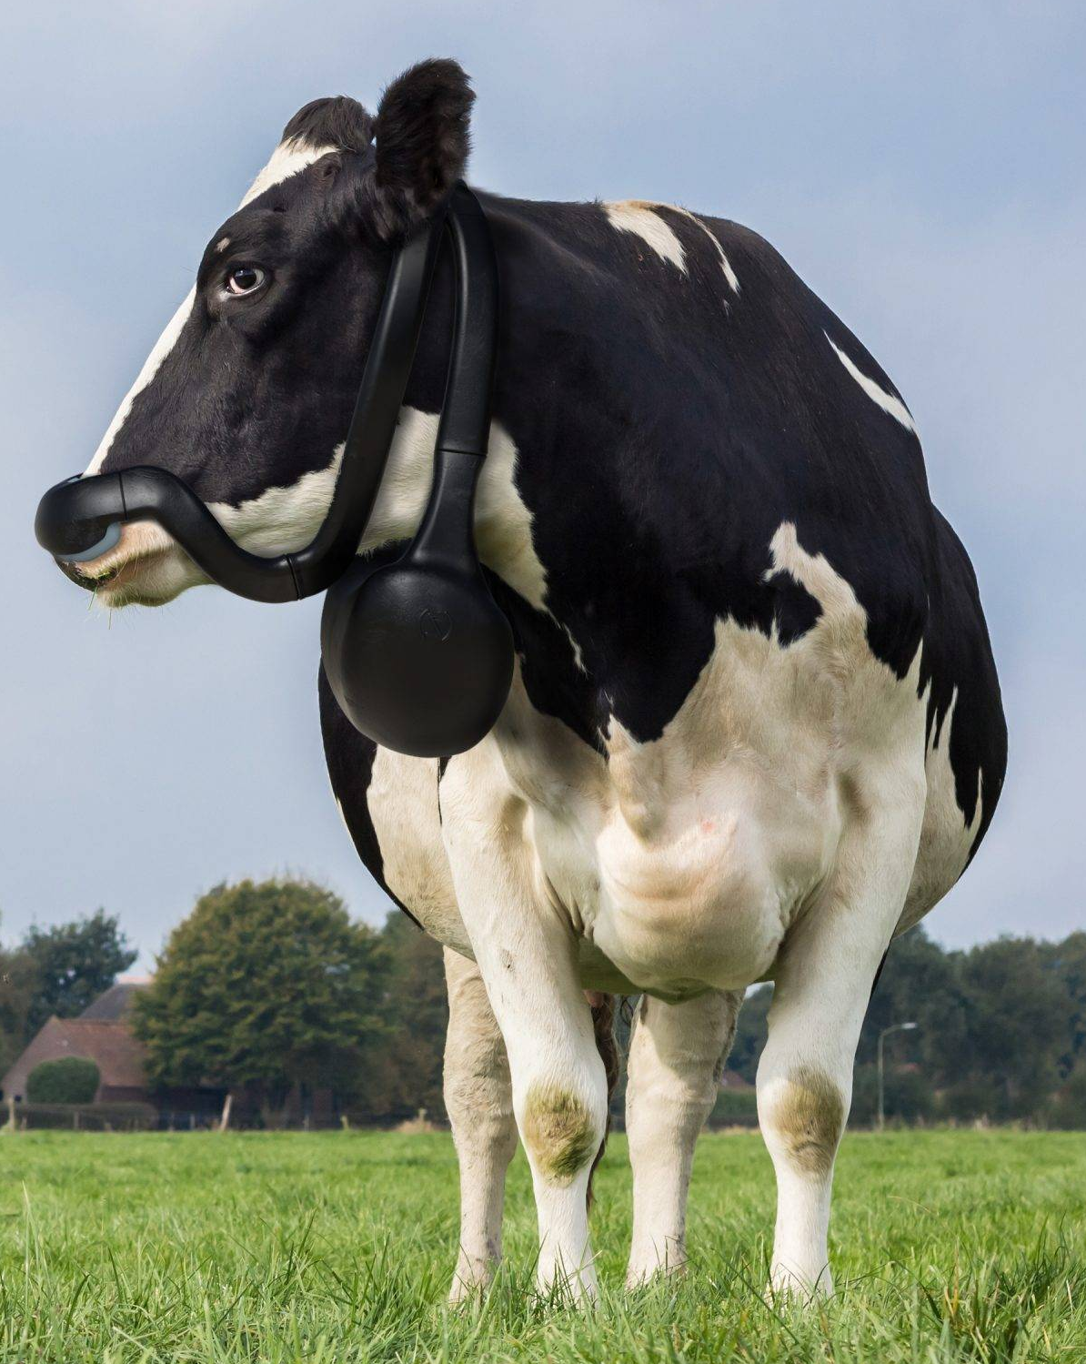
Do we know what we don’t know?
Are new devices suited to life in a freestall barn?
Will new technologies hold up to wear and tear in the field?
Are data networks available where they’re needed?
Can farmers get end-user support when they need it?
Source: Zelp (https://www.zelp.co/).

Slide 27
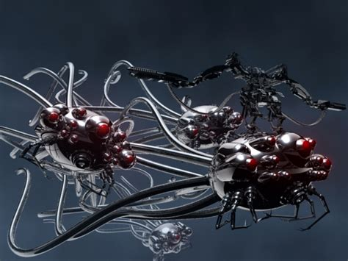
Who will watch the watchers?
Many new tools are black boxes
Who will validate their performance?
What are the gold standards for comparison?
How “good” is good enough for decision-making?

Slide 28
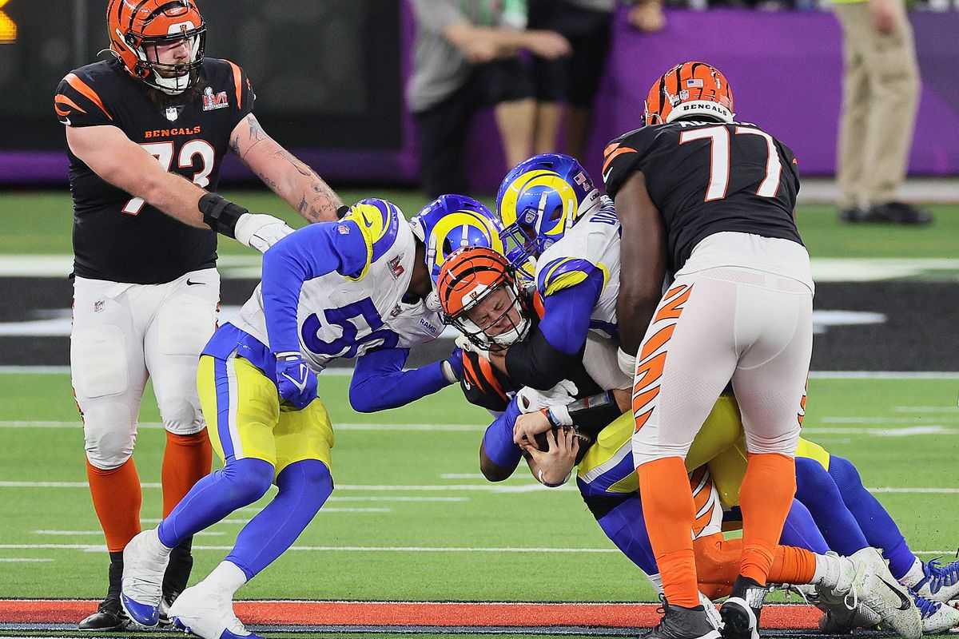
This is a team sport
Genetic improvement programs need lots of people working together
New technologies aren’t magic, and they can’t do everything
We can’t forget that dairy consumers are on the team, too, and what they think matters

Slide 29
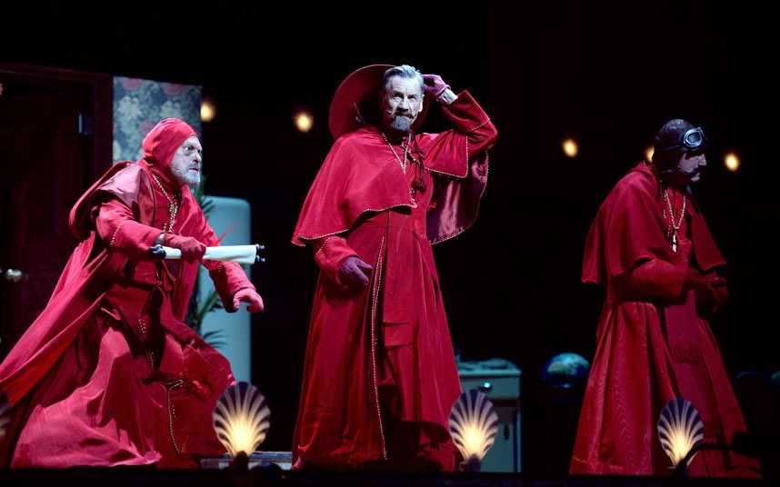
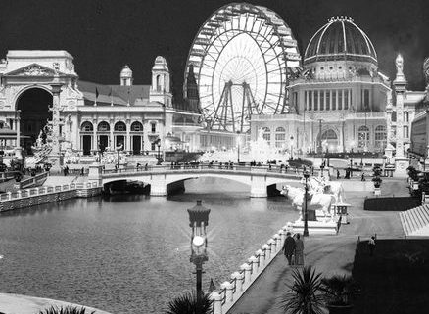
Conclusions
The world around us is changing so we need to change, too
The cow of the future will need to do more with less
We have very powerful tools for creating those cows
Social license will become even more important
Questions?

